Slide 1
Big Mountain Resort Slide Deck
October 17, 2022
Patricia Miranda

Slide 2
Problem Identification
Big Mountain Resort is looking to be profitable from the $1.6M ski lift it has placed, this can be done by modifying their adult ticket prices.
Changing ticket prices will lead to an adequate valuing of their facility.

Slide 3
Recommendation / Key findings
Account what customers are willing to pay and prices of resorts with similar facilities.
Adjust funding to facilities for maintenance and adjusting ticket prices for value of facilities.
Propositions:
Permanently closing up to 10 of the least used runs. This doesn't impact any other resort statistics.
Adding a but requiring the installation of an additional chair lift to bring skiers back up, without additional snow making coverage.
Same as number 2, but adding 2 acres of snow making cover
Increase the longest run by 0.2 mile to boast 3.5 miles length, requiring an additional snow making coverage.
Current ticket price: $81.00
BMR modelled ticket price: $95.87
Expected mean absolute error: $10.39

Slide 4
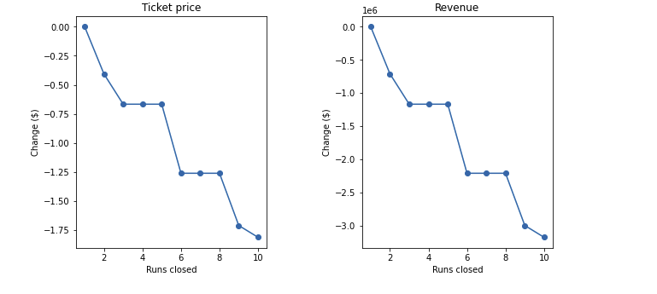
Modeling results / Analysis
Scenarios 1: Closing down 10 unpopular runs at Big Mountain Resort
Currently one of the resorts with most runs (could decrease customers and impact ticket prices)

Slide 5
Modeling results / Analysis
Scenario 2: Adding a new run and adding a new ski-lift.
Attract more customers, and increase revenue with increasing ticket prices by $1.99.
Expected profit: $3,474,638 per season

Slide 6
Modeling results / Analysis
Scenario 3: adding two more acres of snow making
Increases ticket prices by $1.99
Expected amount of revenue per season: $3,474,638
Similar to scenario 2 with insignificant amount of snow making

Slide 7
Modeling results / Analysis
Scenario 4: increasing longest run by 0.2 miles and adding 4 acres of snow making.
No difference in profit with using longest run feature

Slide 8
Summary / Conclusion
Consider benefits/losses of adding new runs vs. closing runs
Calculate costs of closing runs, calculate amount of money saved by decreasing maintenance and snow coverage
Scenario 2 looks most promising as it has shown expected profit with addition of new ski lift.

